Slide 1

Chapter 2 Application Layer
Computer Networking: A Top-Down Approach 8th edition n Jim Kurose, Keith Ross Pearson, 2020
Acknowledgement: Based on the textbook’s website: https://gaia.cs.umass.edu/kurose_ross/index.php
Notes:
Version History
8.1. Updates throughout, including a lot more animations. These are the ppt files used to make Chapter 2 online lectures in Sept. 2020.
8.0 (April 2020)
All slides reformatted for 16:9 aspect ratio
All slides updated to 8th edition material
Use of Calibri font, rather that Gill Sans MT
Add LOTS more animation throughout

Slide 2

Application Layer: Overview
P2P applications
video streaming and content distribution networks
socket programming with UDP and TCP
Principles of network applications
Web and HTTP
E-mail, SMTP, IMAP
The Domain Name System DNS

Slide 3








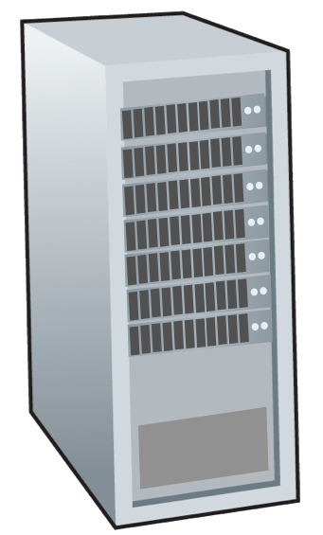







Peer-to-peer (P2P) architecture
IMPORTANT
no always-on server
arbitrary end systems directly communicate
peers request service from other peers, provide service in return to other peers
self scalability – new peers bring new service capacity, and new service demands
peers are intermittently connected and change IP addresses
complex management
examples: P2P file sharing (BitTorrent), streaming (KanKan), VoIP (Skype)
mobile network
national or global ISP
local or regional ISP
home network
content
provider
network
datacenter
network
enterprise
network

Slide 4

File distribution: client-server vs P2P
Q: how much time to distribute file (size F) from one server to N peers?
peer upload/download capacity is limited resource
u_{s}: server upload capacity
d_{i}: peer i download capacity
file, size F
u₁
d₁
u₂
u_{s}
d₂
server
d_{i}
u_{N}
network (with abundant
bandwidth)
u_{i}
d_{N}
u_{i}: peer i upload capacity

Slide 5
File distribution time: client-server
server transmission: must sequentially send (upload) N file copies:
time to send one copy: F/u_{s}
time to send N copies: NF/u_{s}
F
u_{s}
d_{i}
network
client: each client must download file copy
d_{min} = min client download rate
max client download time: F/d_{min}
u_{i}
time to distribute F
to N clients using
client-server approach
D_{c-s} > max{NF/u_{s,},F/d_{min}}
increases linearly in N

Slide 6
File distribution time: P2P
server transmission: must upload at least one copy:
time to send one copy: F/u_{s}
F
u_{s}
client: each client must download file copy
max client download time: F/d_{min}
d_{i}
network
u_{i}
clients: as aggregate must download NF bits
max upload rate (limiting max download rate) is u_{s} + Σu_{i}
time to distribute F
to N clients using
P2P approach
D_{P2P} > max{F/u_{s,},F/d_{min,},NF/(u_{s} + Σu_{i})}
increases linearly in N …
… but so does this, as each peer brings service capacity

Slide 7
Client-server vs. P2P: example
client upload rate = u, F/u = 1 hour, u_{s} = 10u, d_{min} ≥ u_{s}

Slide 8


P2P file distribution: BitTorrent
file divided into 256Kb chunks
peers in torrent send/receive file chunks
tracker: tracks peers
participating in torrent
torrent: group of peers exchanging chunks of a file
Alice arrives …
… obtains list
of peers from tracker
… and begins exchanging
file chunks with peers in torrent

Slide 9


P2P file distribution: BitTorrent
peer joining torrent:
has no chunks, but will accumulate them over time from other peers
registers with tracker to get list of peers, connects to subset of peers (“neighbors”)
while downloading, peer uploads chunks to other peers
peer may change peers with whom it exchanges chunks
churn: peers may come and go
once peer has entire file, it may (selfishly) leave or (altruistically) remain in torrent

Slide 10
BitTorrent: requesting, sending file chunks
Requesting chunks:
at any given time, different peers have different subsets of file chunks
periodically, Alice asks each peer for list of chunks that they have
Alice requests missing chunks from peers, rarest first
Sending chunks: tit-for-tat
Alice sends chunks to those four peers currently sending her chunks at highest rate
other peers are choked by Alice (do not receive chunks from her)
re-evaluate top 4 every10 secs
every 30 secs: randomly select another peer, starts sending chunks
“optimistically unchoke” this peer
newly chosen peer may join top 4

Slide 11

BitTorrent: tit-for-tat
(1) Alice “optimistically unchokes” Bob
(2) Alice becomes one of Bob’s top-four providers; Bob reciprocates
(3) Bob becomes one of Alice’s top-four providers
higher upload rate: find better trading partners, get file faster !

